Slide 1
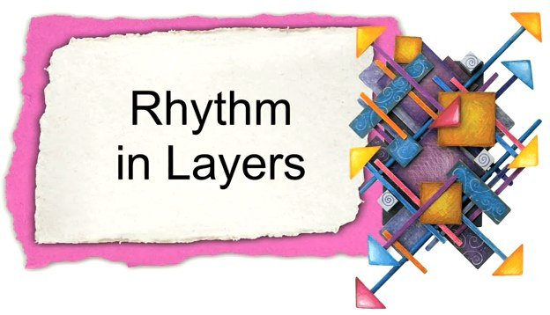

Slide 2
BUILD RHYTHM
Repeating art elements in regular or cyclical fashion to create interest, movement, and/or harmony and unity. Rhythms can be random, regular, alternating, flowing, and progressive.
Rhythm: repetition and placement of similar colors, shapes and lines throughout the collage will provide a sense of order and unity
Balance: Whether placed symmetrically or asymmetrically, collage materials should be arranged so that the visual weight is evenly distributed
Movement: connecting shapes, lines and colors should lead the viewer on a path into, out of and around the entire piece

